Slide 1
WEST OF SCOTLAND HOUSING ASSOCIATION GROUP
ASSET MANAGEMENT STRATEGY 2024 - 27
westscot.co.uk

Slide 2
Overview
1 What is Asset Management ?
Benefits, SHR guidance
2. Considerations in developing strategy
3. Priority investment and activity
4. Delivery and monitoring
4. Strategic Objectives
5. Feedback

Slide 3
WHAT IS ASSET MANAGEMENT ?
Our Asset Management Strategy aims to take account of our legal and regulatory requirements
It sets out our framework and approach on our assets (tenants’ homes, factored properties and commercial/community facilities) to ensure they are sustainable and remain fit for purpose in the short, medium and long term.
SHR - If an asset is fit for purpose, it should be:
managed efficiently and generating demand;
in good condition with a costed, affordable maintenance programme;
making a positive contribution to the landlord’s business plan;
delivering value and amenity.

Slide 4
Benefits of Asset Management Strategy
Supporting our approach to address tenant investment priorities and keep our residents safe in their homes;
Provide affordable homes for our customers that meet Scottish Housing Quality Standards (SHQS) and ultimately meet SHNZS;
Understand the baseline of our stock in terms of energy efficiency and overall stock performance that enables informed, targeted investment ;
Identifies long term capital investment requirements and a measured approach to implementation of this that remains affordable ;
A co-ordinated approach to financial planning through maximisation of grants and other external funding sources ;
Helps shape the procurement of contracts and services that will facilitate improvements to the delivery of customer service and provide greater value for money including community benefits ;
Minimises the proportion of expenditure on day to day repairs and maximise that spent on planned maintenance ;
Addresses challenges related to the Association’s pre 1919 stock
A stock consolidation and acquisition programme that helps focus resources in the core areas of the Association’s communities ;
A new-build development programme that grows the asset base in a sustainable way and provides new homes that meet current and future needs

Slide 5
SHR – 5 KEY PRINCIPLES
Principle 1: Governing bodies and committees lead the strategic response to asset management and should be assured that assets are managed effectively (assurance and strategic response)
Principle 2: Social landlords should have a comprehensive understanding of their assets (understand assets)
Principle 3: Social landlords should develop an approach to understanding the value of their assets (valuing assets)
Principle 4: Integrated asset management outcomes should be understood and used as evidence to inform future investment decisions (understand and use assets)
Principle 5: Social landlords should use the integrated asset management outcomes to inform their asset management strategies (inform strategies)

Slide 6
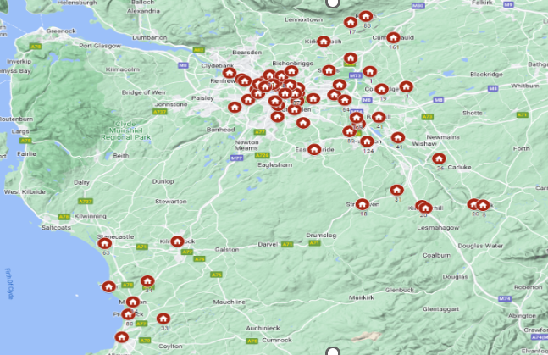
Our Stock
Investment Profile
Stock Number | Avg. Annual Investment | 1 year Avg p/u | 5 year Avg p/u | 30 year Avg p/u
4, 429 | £8.9m | £1,991 | £9,960 | £59,760
£267,000,000 over life of business plan

Slide 7
CONSIDERATIONS
Key Drivers
eg Safety and Compliance , Scottish Housing Net Zero Standards, SHQS, Scottish Government & LA Strategies, Customer Expectations, WSHA Strategies, Construction sector constraints and inflation
Developing a Comprehensive Understanding of our Assets
- SCS, repairs and void data, Asset Pro, CX, Core KPI data, demand, turnover, customer feedback,
Business as Usual – safety, repairs, component investment, major repairs, compliance, maintenance, medical adaptations, factoring, procurement
Consultation – responses to customer surveys ; technical teams ; CMT ; staff T&D ; TAG
What are Our Priority Investment & Activity?
- covered in the action plan
Risk Assessment for Delivery – strategic risk assessment undertaken ; ongoing monitoring

Slide 8
PRIORITY INVESTMENT & ACTIVITY
Scottish Housing Net Zero Standards (SHNZS)
A fabric efficiency rating (focused on the amount of energy for heat consumed by a property), measured in kWh/m2/year
A requirement to replace ‘direct emissions heating’ systems with a clean heating alternative by a backstop date of 2045
Overtown Street and Law Street, Glasgow – comprehensive refurbishment
Double Glazed Sash and Case Windows on Former Charing Cross HA stock

Slide 9
PRIORITY INVESTMENT & ACTIVITY
Kirkfieldbank, South Lanarkshire & Springburn, Glasgow : “Electric Wallpaper” Pilots
- first in Scotland to trial this innovation
Dampness & Mould
-Internet of Things Pilot ; Proof of Concept trials
Hill Street, Glasgow : Dispute
structural issues ; roof
Barrowfield Community Centre, Glasgow
- develop and begin implementation of project plan to deliver fabric improvements and more efficient zero carbon heating system
Develop long term plan for replacement of heating in sheltered blocks

Slide 10
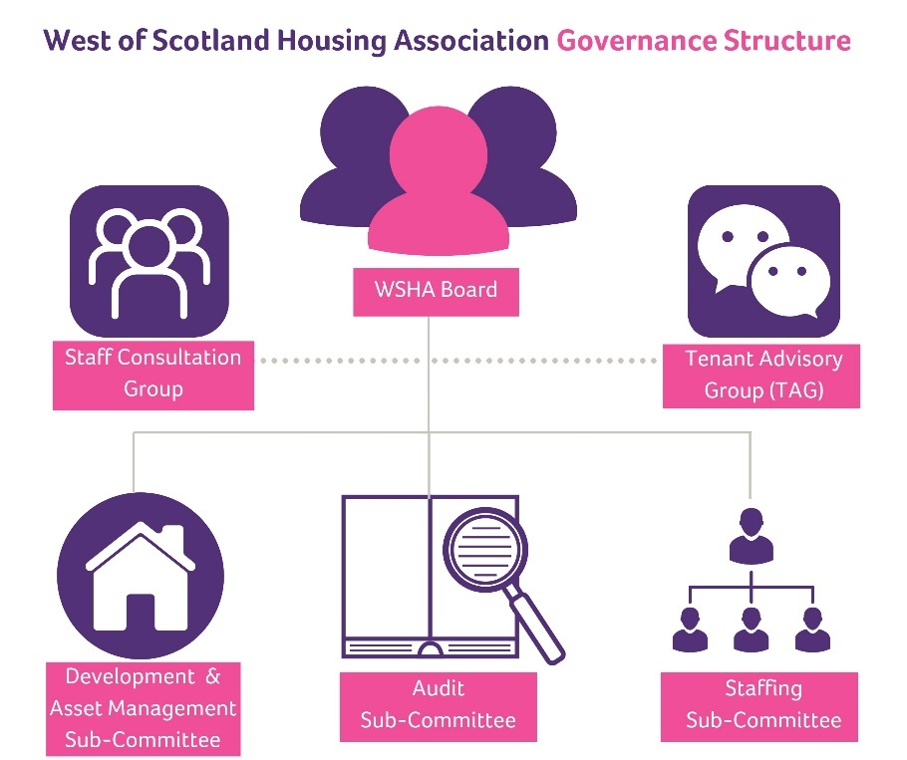
DELIVERY & MONITORING
Board lead on WSHA’s strategic response to asset management.
Monitoring progress and delivery of the asset management strategy delegated to the Development and Asset Management Sub Committee (DAMSC).
Director of Development and Asset Management responsible for implementation, reporting and overall delivery
Asset Manager, Maintenance Manager and Development Manager responsible for delivery of relevant elements of the strategy and delegated to them by the DoDAM.

Slide 11
DELIVERY
4 Key Strategic Objectives
Develop and begin Implementation of a Delivery Plan for Social Housing Net Zero Standard
Improve the knowledge we hold on our assets and how they are performing and develop our asset management database and repairs system
Deliver programmes of work to address priority investment needs in existing stock.
Update WSHA’s Consolidation Strategy and Develop Action Plan

Slide 12
Financial Planning
business as usual operations fully funded as part of our business planning approach over 5 and 30 years
New build programme funded through bank loans (private finance)
Scottish Housing Net Zero Standard cost prohibitive sector-wide
-estimated by SG to cost £14k p/u to convert from gas to clean heating
511,000 SR units with gas = £7.14bn
- working with Warmworks
- strategic overview of stock and meeting SHNZS
maximise grants SHNZ funding, match funding ; Energy Company Obligations (ECO)

Slide 13
Consultation
Customer surveys – Cost of Living Crisis responses
Technical teams
CMT
Staff T&D
TAG

